Slide 1

Final Software Project Presentation
Cortilious Spencer
CST499: Capstone for Computer Software
Dr. Charmelia Butler
December 02, 2025
Notes:
Hello, my name is Cortilious Spencer, and this presentation covers my Final Software Project for CST499. I’ll walk through the SRS, UML diagrams, system design, MySQL database, PHP development, testing, and lessons learned.

Slide 2
Agenda
Overview of SRS key components
UML diagrams developed for the system
Design of landing, login, and registration pages
Enrollment page and workflow
MySQL database structure and tables
PHP code and backend implementation
Testing summary and final project reflection
Notes:
This presentation will cover the major components of my final software project.
I’ll start by summarizing the key elements of the SRS document, then move into the UML model that guided the system’s design.
Next, I’ll walk through the landing, login, registration, and enrollment pages I developed.
Then I’ll discuss the MySQL database and the class registration features.
I’ll also highlight the PHP code used to build the system, and finally, I’ll end with a short testing summary and overall reflection of what I learned in this project.

Slide 3
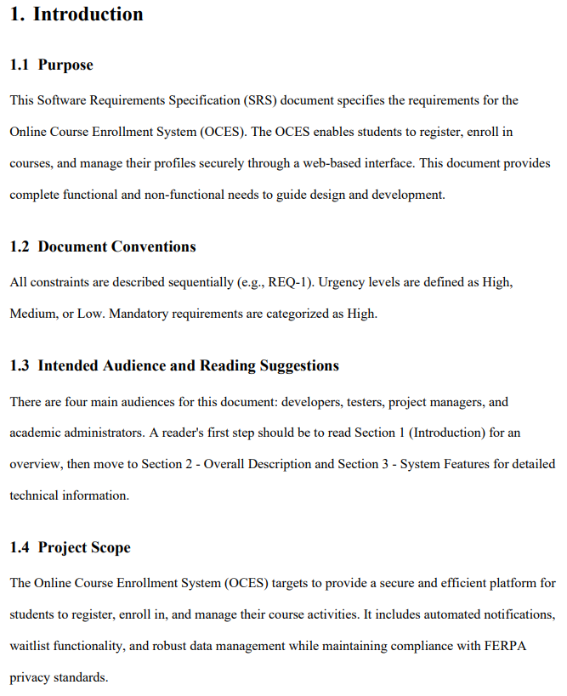
SRS Summary
Defines overall purpose and scope of the system
Identifies students and administrators as primary users
Functional requirements: login, registration, course browsing, enrollment
Nonfunctional requirements: security, performance, usability, reliability
Establishes a clear blueprint for development and testing
Notes:
The SRS document defines the purpose and requirements of the Online Course Registration System.
It includes the system’s main goals, the user roles involved, and the functional and nonfunctional requirements.
Functionally, the system must allow students to register, log in, browse courses, enroll in classes, and view or remove registered courses.
Nonfunctional requirements ensure security, usability, performance, and reliability.
This document essentially served as the blueprint for everything developed in this project.

Slide 4

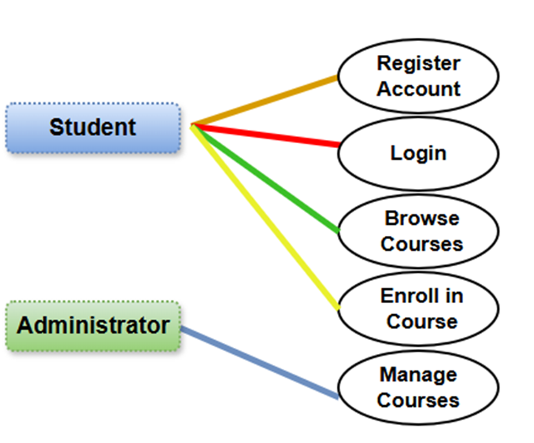
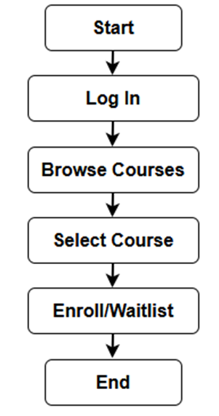
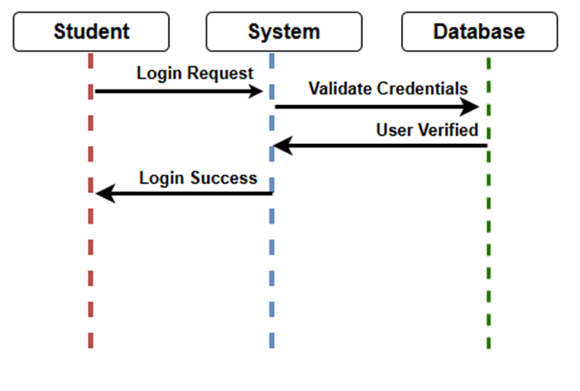
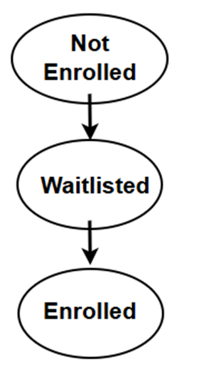
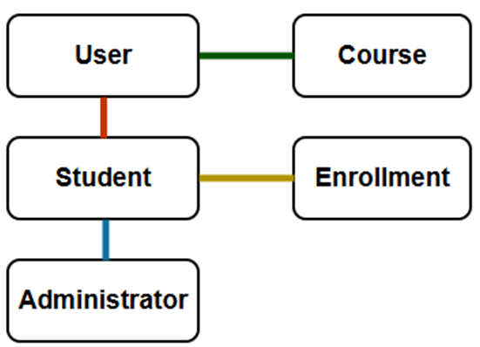
UML Overview
UML diagrams visualize system structure and behavior
Class diagram defines key system entities and relationships
Use case diagram outlines user interactions and system functions
Sequence diagram shows request and response flows
Activity and state diagrams map system processes and transitions
Provides clarity before implementation begins
Notes:
The UML model helped visualize the system’s structure and behavior before coding began.
It includes the class diagram, use case diagram, sequence diagram, activity diagram, and state diagram.
These diagrams helped clarify interactions between the user, system components, and the database.
Each UML element ensured that the project stayed aligned with the requirements defined in the SRS.

Slide 5
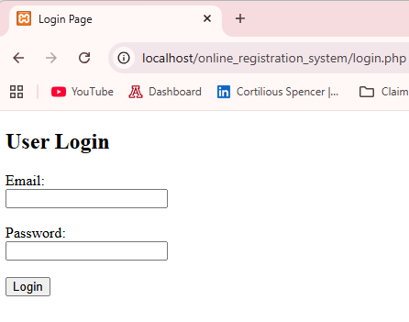
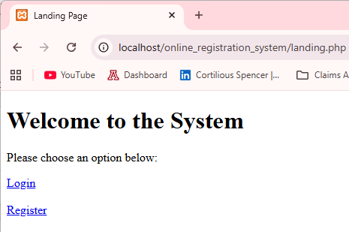
Landing / Login Pages
Landing page offers direct access to login and registration
Login page validates user credentials securely
Registration page stores new user accounts with hashed passwords
Interface designed for simplicity and easy navigation
Supports authentication for all protected system pages
Notes:
The landing page serves as the system’s entry point and provides clear navigation choices for login or registration.
The login page verifies user credentials through PHP and MySQL using secure password hashing.
The registration page collects new user information and stores it in the database.
Together, these pages form the foundation of the user authentication process.

Slide 6
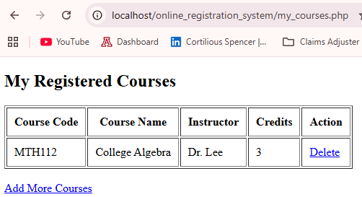
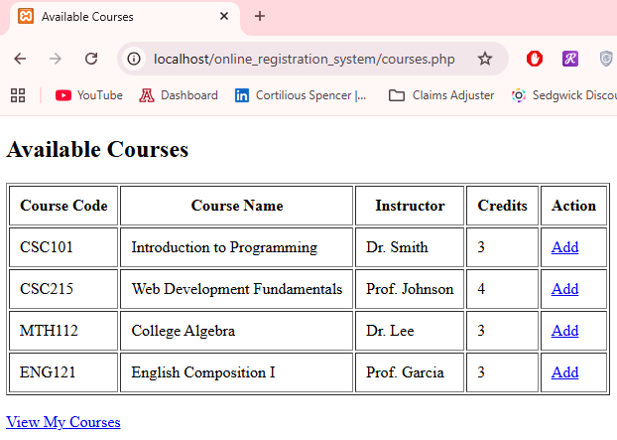
Enrollment Pages
Displays full list of courses from the database
Students can enroll in or remove courses instantly
“My Courses” page shows classes already registered
Updates reflect real-time changes in the SQL tables
Structured for clarity and smooth user experience
Notes:
The enrollment page displays all available courses pulled directly from the database.
Students can add or remove classes, and these actions update the registrations table in real time.
The page layout and logic were designed to be simple and user-friendly.
This section also includes the “My Courses” page, where students can view and drop previously added classes.

Slide 7
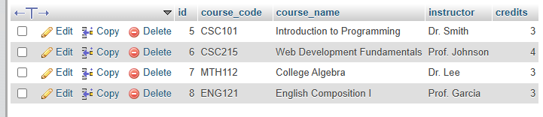
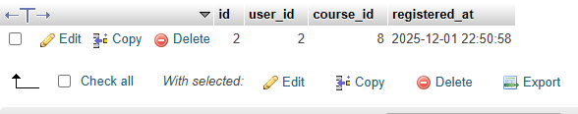
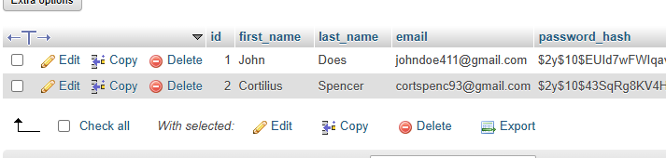
MySQL Database
Three main tables: Users, Courses, Registrations
Users table contains secure account and login data
Courses table holds course details and instructor info
Registrations table maps user enrollments to course IDs
Primary/foreign keys ensure data integrity and consistency
Notes:
The database consists of three main tables: Users, Courses, and Registrations.
The Users table stores account information with hashed passwords.
The Courses table holds metadata like course code, name, credits, and instructors.
The Registrations table connects users to their selected courses and is updated each time a user enrolls or deletes a class.
The structure ensures data integrity and supports all core system feature

Slide 8
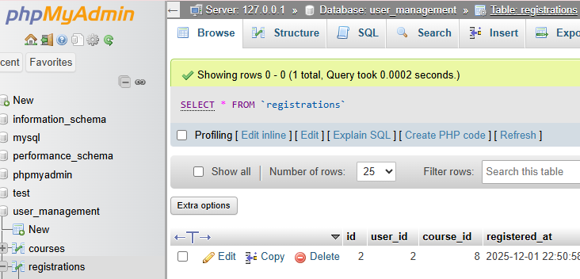
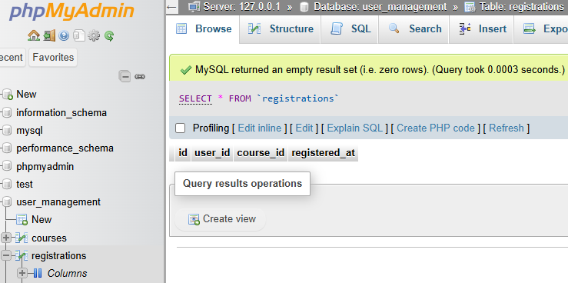
Registration Workflow
SQL INSERT creates new course registrations
SQL DELETE removes existing course selections
Before-and-after table views confirm successful updates
Logic supports multiple enrollments per user
Workflow reflects accurate real-time system behavior
Notes:
The registration workflow uses SQL statements to insert or delete records in the Registrations table.
Screenshots of the database before and after each operation confirm that the SQL logic works correctly.
Adding a course creates a new record, and removing one deletes the corresponding row.
These before/after snapshots prove the system is functioning as intended.

Slide 9
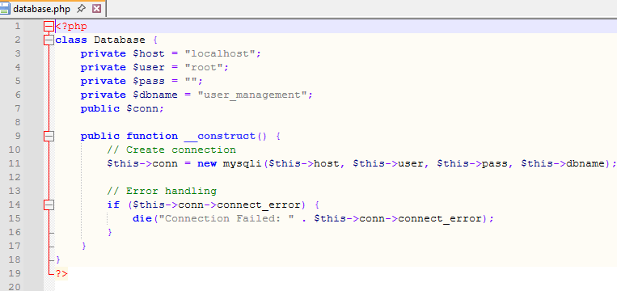
PHP Code Overview
database.php establishes MySQL connection class
register.php handles new account creation and hashing
login.php verifies stored credentials securely
Other scripts manage course enrollment actions
PHP drives dynamic pages and server-side logic
Notes:
PHP powers the backend functionality of the system.
The database.php file establishes a secure connection to MySQL.
The process_register.php file handles new user accounts using password hashing.
The process_login.php script verifies credentials and either logs the user in or returns an error.
Other files manage course enrollment actions, retrieving course data, and displaying user-specific content.

Slide 10

Key PHP Features
Secure password hashing using PHP’s default algorithm
CRUD operations for enrollment and user data
Session handling ensures protected routes
Error checking for invalid inputs or failures
Clean, organized structure for easier maintenance
Notes:
Some key features include secure password hashing, CRUD operations for the course registration system, and dynamic content retrieval.
Session handling ensures that pages requiring authentication cannot be accessed without logging in.
Overall, the PHP code demonstrates clean logic, clear organization, and proper use of database interactions.

Slide 11
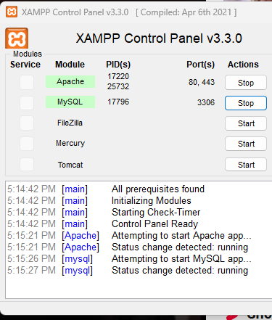
Testing Summary
Unit testing validated individual PHP functions
Integration testing checked interactions with MySQL
System testing verified workflows end-to-end
All tests traced back to SRS requirements
Ensured reliability before final deployment
Notes:
Testing included unit, integration, and system-level checks.
I verified the database connection, tested registration and login logic, and confirmed the enrollment workflow.
Each test was guided by requirements from the SRS to ensure full coverage.
By validating every feature, I ensured the system works correctly and reliably before final submission.

Slide 12
Reflection
Strengthened skills in PHP, SQL, and full-stack concepts
Gained experience using UML for planning and design
Learned to debug database and login issues
Improved understanding of testing processes
Overall, project enhanced my technical confidence
Notes:
This project strengthened my skills in web development, database management, and software design.
I learned how to convert an SRS into a working system and how UML diagrams support planning and implementation.
I also gained hands-on experience writing PHP, designing MySQL tables, and debugging issues along the way.
Overall, this was a valuable learning experience that helped me grow technically and professionally.

Slide 13
References
Tsui, F., Karam, O., & Bernal, B. (2018). Essentials of software engineering (4th ed.). Jones & Bartlett Learning.
IEEE Computer Society. (2014). IEEE standard for software quality assurance processes (IEEE Std 730-2014).
Chillarege, R., Bhandari, I. S., Chaar, J. K., Halliday, M. J., Moebus, D. S., Ray, B. K., & Wong, M.-Y. (1992). Orthogonal defect classification—A concept for in-process measurements. IEEE Transactions on Software Engineering, 18(11), 943–956.

